Slide 1
Get up to Speed
Quick guide to DATA.TABLE IN r and Pentaho PDI
02 09 2015
Serban Tanasa

Slide 2
What You Could Gain Tonight
2-20x speed increase in your data loading and manipulation using data.table
(If time allows) A free path of entry into Business Intelligence ETL (commercial scale computing technologies for Extract/Transform/Load) using Pentaho Data Integration.
Free food?

Slide 3
Planned Outline
data.table
Why use it? Benchmarks.
How to use it? Primer on basic functions.
Overcome R scaling limitations: Multithread, Cloud, Databases.
Pentaho Data Integration (PDI)
(Optional time-constrained section) Very basic run-through of PDI ETL
Unstructured Time for Q&A and (potentially) hilarious live-coding

Slide 4
R Online Support and Business Use
Source: Stack Overflow, Talk Stats, and Cross Validated

Slide 5
Benchmarks
Read Data
ORDER DATA
Transform Data

Slide 6

Benchmarks: Hardware Setup
Test Machine: AWS EC2 r3.8xlarge
# R version 3.2.2 (2014-07-10) -- “Fire Safety”
# Platform: x86_64-pc-linux-gnu (64-bit)
An Amazon Web Services Elastic Cloud Compute on-demand instance with these settings costs $2.8/hr on demand, ~$1/hr reserved, or as low as ~0.3/hr on spot instances.

Slide 7
Benchmarks: Reading Data

Slide 8
Benchmarks: Reading Data

Slide 9
Benchmarks: Order Data

Slide 10
Benchmarks: Order Data

Slide 11
Benchmarks: Transform Data (Setup)
The input data is randomly ordered. No pre-sort. No indexes. No key.
5 simple queries are run: large groups and small groups on different columns of different types. Similar to what a data analyst might do in practice; i.e., various ad hoc aggregations as the data is explored and investigated.
Each package is tested separately in its own fresh session.
Each query is repeated once more, immediately. This is to isolate cache effects and confirm the first timing.
The results are compared and checked allowing for numeric tolerance and column name differences.
It is a tough test that happens to be realistic and very common.

Slide 12
Benchmarks: Transform Data (Setup)
N=1e9; K=100
set.seed(1)
DF <- data.frame(stringsAsFactors=FALSE,
id1 = sample(sprintf("id%03d",1:K), N, TRUE),
id2 = sample(sprintf("id%03d",1:K), N, TRUE),
id3 = sample(sprintf("id%010d",1:(N/K)), N, TRUE),
id4 = sample(K, N, TRUE),
id5 = sample(K, N, TRUE),
id6 = sample(N/K, N, TRUE),
v1 = sample(5, N, TRUE),
v2 = sample(5, N, TRUE),
v3 = sample(round(runif(100,max=100),4), N, TRUE) )

Slide 13
id1 | id2 | id3 | id4 | id5 | id6 | v1 | v2 | v3
id027 | id007 | id0000000022 | 42 | 60 | 58 | 4 | 4 | 50.7016
id038 | id068 | id0000000012 | 15 | 56 | 71 | 4 | 4 | 5.5459
id058 | id074 | id0000000015 | 46 | 60 | 34 | 5 | 1 | 11.5124
id091 | id012 | id0000000031 | 81 | 40 | 12 | 1 | 1 | 18.8075
id021 | id005 | id0000000016 | 33 | 27 | 88 | 2 | 3 | 34.0231
id090 | id014 | id0000000053 | 87 | 74 | 6 | 2 | 3 | 27.2783
id095 | id089 | id0000000012 | 25 | 3 | 35 | 2 | 5 | 11.5124
id067 | id084 | id0000000048 | 83 | 85 | 47 | 5 | 1 | 63.7503
id063 | id087 | id0000000031 | 22 | 86 | 78 | 2 | 4 | 23.251
id007 | id004 | id0000000031 | 58 | 14 | 82 | 2 | 5 | 7.1864
id021 | id011 | id0000000030 | 37 | 39 | 69 | 5 | 1 | 49.0202
id018 | id055 | id0000000066 | 95 | 86 | 1 | 1 | 2 | 4.0548
id069 | id011 | id0000000039 | 11 | 8 | 71 | 5 | 2 | 45.0637
id039 | id073 | id0000000075 | 54 | 23 | 50 | 5 | 4 | 89.157
id077 | id073 | id0000000069 | 9 | 77 | 73 | 4 | 2 | 22.9517
id050 | id079 | id0000000027 | 29 | 34 | 17 | 3 | 4 | 23.251
id072 | id062 | id0000000041 | 67 | 98 | 53 | 4 | 1 | 73.6784
id100 | id051 | id0000000051 | 13 | 15 | 55 | 1 | 3 | 54.3411
id039 | id046 | id0000000090 | 100 | 77 | 79 | 1 | 2 | 7.1864
id078 | id004 | id0000000009 | 68 | 97 | 10 | 2 | 2 | 40.3839

Slide 14
Benchmarks: Test Commands
Test | data.table | dplyr
1.1 | DT[, sum(v1), keyby=id1] | DF %>% group_by(id1) %>% summarise(sum(v1))
1.2 | DT[, sum(v1), keyby=id1] | DF %>% group_by(id1) %>% summarise(sum(v1))
2.1 | DT[, sum(v1), keyby="id1,id2"] | DF %>% group_by(id1,id2) %>% summarise(sum(v1))
2.2 | DT[, sum(v1), keyby="id1,id2"] | DF %>% group_by(id1,id2) %>% summarise(sum(v1))
3.1 | DT[, list(sum(v1),mean(v3)), keyby=id3] | DF %>% group_by(id3) %>% summarise(sum(v1),mean(v3))
3.2 | DT[, list(sum(v1),mean(v3)), keyby=id3] | DF %>% group_by(id3) %>% summarise(sum(v1),mean(v3))
4.1 | DT[, lapply(.SD, mean), keyby=id4, .SDcols=7:9] | DF %>% group_by(id4) %>% summarise_each(funs(mean), 7:9)
4.2 | DT[, lapply(.SD, mean), keyby=id4, .SDcols=7:9] | DF %>% group_by(id4) %>% summarise_each(funs(mean), 7:9)
5.1 | DT[, lapply(.SD, sum), keyby=id6, .SDcols=7:9] | DF %>% group_by(id6) %>% summarise_each(funs(sum), 7:9)
5.2 | DT[, lapply(.SD, sum), keyby=id6, .SDcols=7:9] | DF %>% group_by(id6) %>% summarise_each(funs(sum), 7:9)

Slide 15
Benchmarks: Results
Microseconds

Slide 17
data.table Primer
READ
CREATE
Manipulate
Special Commands

Slide 18
Read
fread()
Similar to read.table but faster and more convenient. All controls such as sep, colClasses and nrows are automatically detected. bit64::integer64 types are also detected and read directly without needing to read as character before converting.
sep -- The separator between columns. Defaults to the first character in the set [,\t |;:] that exists on line autostart outside quoted regions, and separates the rows above autostart into a consistent number of fields, too.
skip, drop, select, showProgress;
Input can be a file name, a URL pointing to a file, or (advanced use) a shell command fread("grep @WhiteHouse.gov filename"))

Slide 19
Create
data.table() – much like data.frame
setDT() – makes an existing data.frame a data.table without copying (this is important for large data)
setkey() and setkeyv() – supercharged rownames, indices

Slide 20
Manipulate
:= : Assignment operator (without copy)
.N : Counts
data.table::melt(), data.table::dcast()
data.table::merge() and DT_1[DT_2] joins
DT[ i, j, by ]

Slide 21
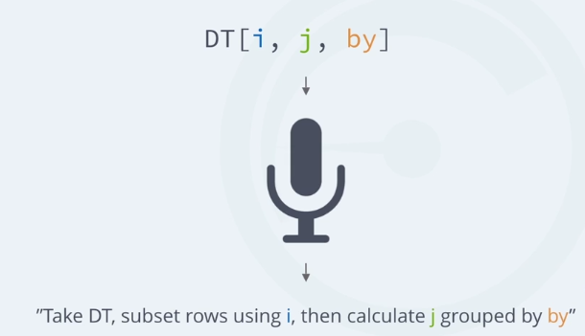
DT[i, j, by] format
Source: https://campus.datacamp.com/courses/data-table-data-manipulation-r-tutorial

Slide 22
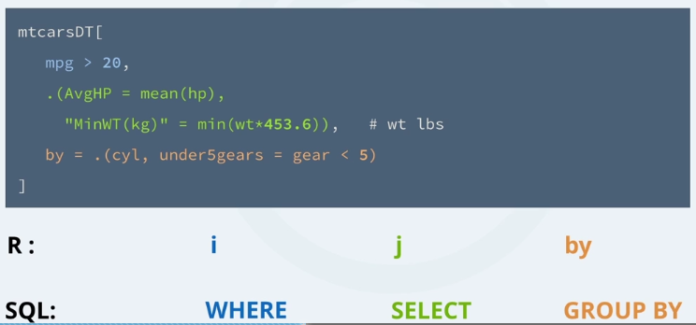
DT[i, j, by] format
Source: https://campus.datacamp.com/courses/data-table-data-manipulation-r-tutorial

Slide 23
Special Commands
.( )
.eachi
.SD and .SDcols
c('x2', 'y2') := list(..., ...)
`:=`(x2=...,y2= ...) equivalent group assignment
DT[, plot(x)] will actually produce a plot
copy() – for when you do not want to update by reference
DT[, “colname”, with=FALSE]
DT[…][…] -- Chaining

Slide 24
Overcome R scaling limitations
Multithread R
Cloud
Databases
Specialize R USE

Slide 25

Multithread R: RRO 3.2.1
Enhancements include multi-core processing…
https://mran.revolutionanalytics.com/download/

Slide 26
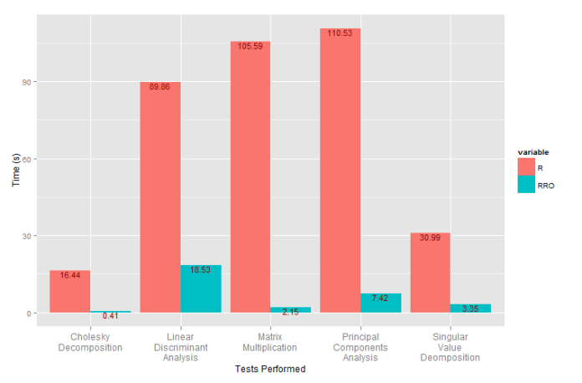
http://serbantanasa.com/2015/06/12/r-vs-revolution-r-open-3-2-0/

Slide 27




Cloud, Database, BI Tools
AWS
On-Off Deployment of memory-optimized instances for one-off heavy processing
AWS with Rstudio Server + Shiny Server (Linux Only)
R is increasingly integrated in BI tools and even Databases
Pentaho EE has R integration (as does Microstrategy, Microsoft SSRS, IBM, and even data discovery tools like Tableau, Qlikview & Alteryx)
IBM DashDB has a built-in Rstudio, MS SQL Server 2016 will have in-database R, Postgres has PL/R etc.

Slide 28

Specialize Your Use of R
R can do anything you can program (it is a Turing-complete programming language)
R should NOT do everything.
Push ETL to specialized software (like PDI)
Push computation to DB (DBI and rstats-db packages) & Hadoop (Rhadoop – basically large scale lapply)
https://github.com/rstats-db

Slide 29
Pentaho PDI
Overview of Capabilities

Slide 30
What PDI can do for you
Data integration without writing 1 line of code
Heavily parallel streams (compare to base-R 1 core), can even push to a whole slave computing cluster.
Java, JavaScript, SQL, R Scripting (EE?)
Slowly changing dimensions made easy

Slide 31
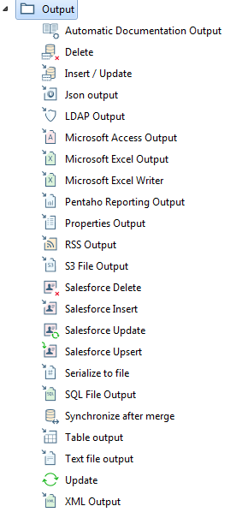
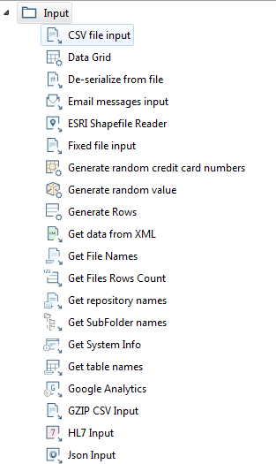
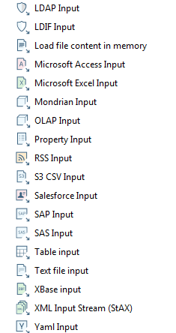
Data I/O Capabilities

Slide 32
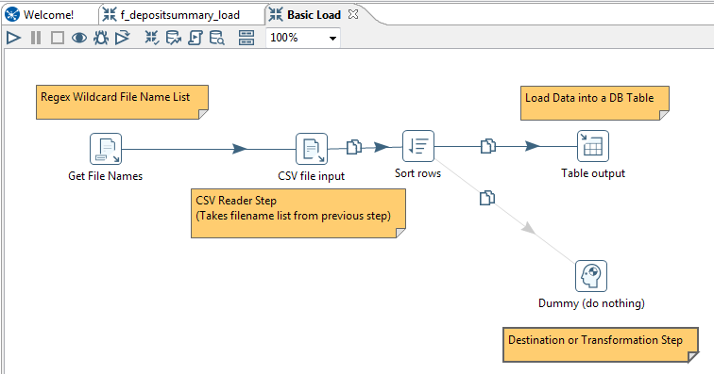
Visual Data Munging

Slide 33
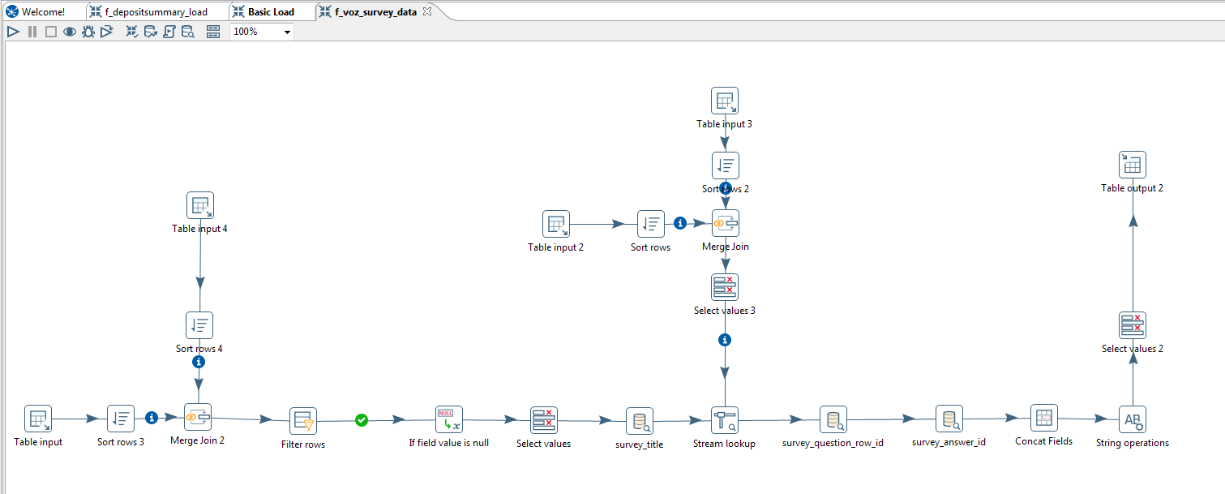
Complexity can escalate quickly…

Slide 34

Additional Resources: PDI
Community Version:
http://community.pentaho.com/projects/data-integration/
Enterprise Edition
http://www.pentaho.com/product/data-integration

Slide 35
Additional Resources: data.table
data.table wiki:
https://github.com/Rdatatable/data.table/wiki
data.table tutorial:
https://campus.datacamp.com/courses/data-table-data-manipulation-r-tutorial/

Slide 36

Thank you for your time!
stanasa@sunstonescience.com

Slide 37
Appendix

Slide 38
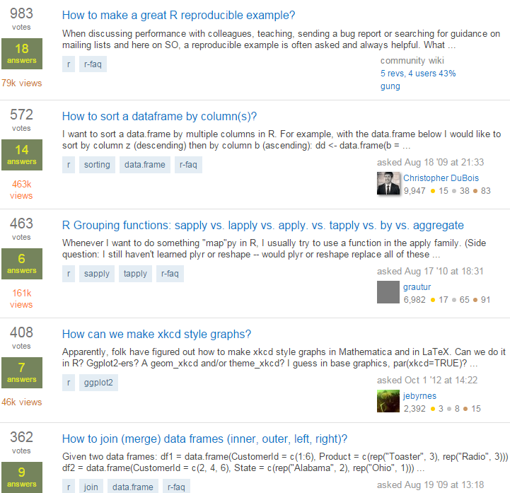
Stack Overflow

Slide 39
Benchmark Test
Data Size (GB) | <0.01 | <0.012 | 0.03 | 0.075 | 0.516 | 4.939 | 49.15
Rows | 1.00E+03 | 1.00E+04 | 1.00E+05 | 1.00E+06 | 1.00E+07 | 1.00E+08 | 1.00E+09
DF %>% group_by(id1) %>% summarise(sum(v1)) | 6,729 | 7,074 | 10,737 | 49,100 | 468,973 | 5,076,499 | 51,998,307
DT[, sum(v1), keyby=id1] | 5,300 | 5,305 | 6,708 | 20,656 | 216,540 | 2,730,619 | 28,076,861
DF %>% group_by(id1) %>% summarise(sum(v1)) | 1,188 | 1,642 | 5,344 | 43,524 | 455,865 | 5,128,423 | 51,528,819
DT[, sum(v1), keyby=id1] | 953 | 1,123 | 2,486 | 16,416 | 210,032 | 2,721,640 | 27,406,794
DF %>% group_by(id1,id2) %>% summarise(sum(v1)) | 1,894 | 8,480 | 28,033 | 152,965 | 1,444,988 | 14,927,984 | 152,535,515
DT[, sum(v1), keyby="id1,id2"] | 1,263 | 2,559 | 5,516 | 26,446 | 361,812 | 4,827,830 | 51,897,539
DF %>% group_by(id1,id2) %>% summarise(sum(v1)) | 1,865 | 8,396 | 27,343 | 153,185 | 1,440,788 | 14,652,509 | 152,118,605
DT[, sum(v1), keyby="id1,id2"] | 1,257 | 2,561 | 5,505 | 26,386 | 355,492 | 4,827,702 | 54,047,731
DF %>% group_by(id3) %>% summarise(sum(v1),mean(v3)) | 1,130 | 1,697 | 10,323 | 129,391 | 1,805,955 | 45,748,652 | 693,700,832
DT[, list(sum(v1),mean(v3)), keyby=id3] | 1,197 | 1,461 | 3,910 | 40,991 | 710,813 | 16,582,213 | 233,001,218
DF %>% group_by(id3) %>% summarise(sum(v1),mean(v3)) | 1,100 | 1,701 | 10,299 | 125,585 | 1,824,419 | 44,038,141 | 627,247,199
DT[, list(sum(v1),mean(v3)), keyby=id3] | 1,160 | 1,415 | 3,894 | 40,895 | 713,289 | 16,660,202 | 209,734,867
DF %>% group_by(id4) %>% summarise_each(funs(mean), 7:9) | 2,463 | 2,900 | 6,965 | 51,318 | 591,011 | 8,421,787 | 86,594,397
DT[, lapply(.SD, mean), keyby=id4, .SDcols=7:9] | 1,091 | 1,354 | 3,603 | 29,196 | 314,705 | 3,711,641 | 38,151,119
DF %>% group_by(id4) %>% summarise_each(funs(mean), 7:9) | 1,811 | 2,276 | 6,328 | 49,939 | 579,184 | 8,315,717 | 86,585,169
DT[, lapply(.SD, mean), keyby=id4, .SDcols=7:9] | 1,056 | 1,322 | 3,614 | 26,572 | 310,265 | 3,706,489 | 37,275,816
DF %>% group_by(id6) %>% summarise_each(funs(sum), 7:9) | 1,729 | 2,234 | 8,268 | 94,044 | 1,661,863 | 41,141,396 | 600,233,695
DT[, lapply(.SD, sum), keyby=id6, .SDcols=7:9] | 1,049 | 1,343 | 4,053 | 39,299 | 529,329 | 7,016,574 | 120,664,934
DF %>% group_by(id6) %>% summarise_each(funs(sum), 7:9) | 1,696 | 2,207 | 8,189 | 93,323 | 1,660,917 | 41,126,264 | 625,999,220
DT[, lapply(.SD, sum), keyby=id6, .SDcols=7:9] | 1,055 | 1,343 | 4,033 | 38,910 | 529,763 | 6,602,454 | 125,725,448

